Slide 1
Reading in Key Stage Two
A guide for parents/carers to help support their children in developing their reading

Slide 2


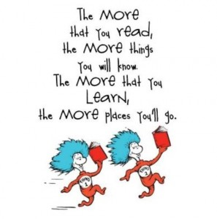

Slide 3

Why Read?
Reading is an important life skill.
It supports learning across the curriculum.
Reading benefits communication skills
Support the development of writing skills
Encourages imagination/creativity
Supports an memory skills
It provides an escape/reduces stress

Slide 4
Reading for pleasure – a main focus of the English Curriculum
Many of the national curriculum objectives for reading focus on building positive attitudes towards reading.
  An example objective from the National Curriculum:
    [EXS] Maintain positive attitudes to reading and understanding of what they read by continuing to read and discuss an increasingly wide range of fiction, poetry, plays, non-fiction and reference books or textbooks.
    ⤷ GD objective: Maintain positive attitudes to reading and understanding of what they read by continuing to read, compare and evaluate an increasingly wide range of fiction, poetry, plays, non-fiction and reference books or textbooks.
8 out of 21 of the Year 6 objects for reading focus on developing positive attitudes towards reading
Other year groups follow a similar pattern.

Slide 5
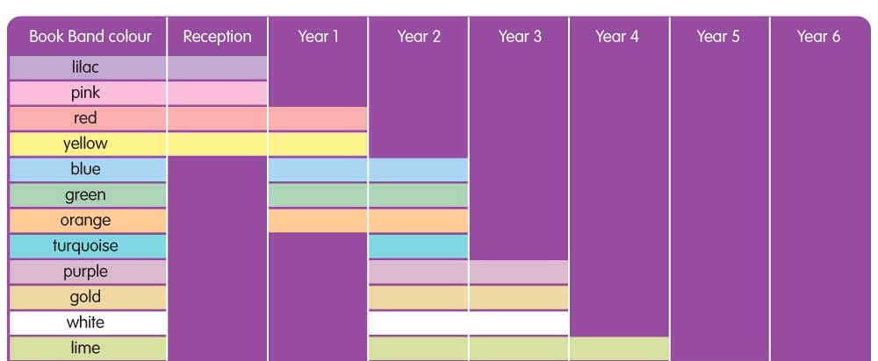
School Reading Scheme
Our school reading scheme is divided into bands which the children work through as their reading skills develop. The initial bands are linked to their progress in phonics.
The children need to be able to both read the books fluently and demonstrate a good understanding (comprehension) of what they have read before teachers will move children onto the next band.
All children are assessed regularly.

Slide 6
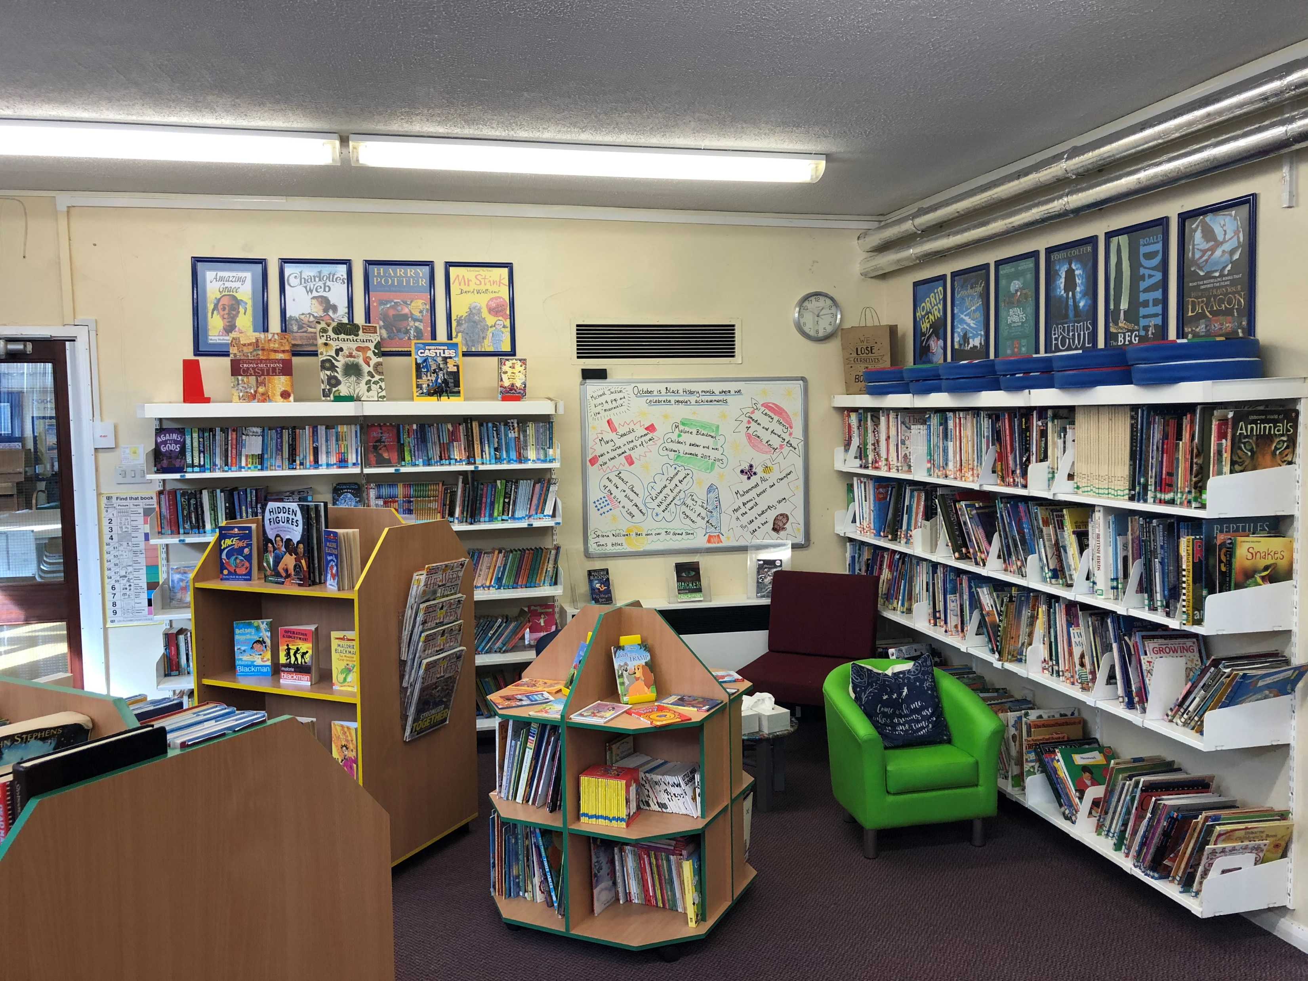
Library Level – Free Readers
When a child has moved through the appropriate levels on the reading scheme, they are classed as a free-reader and they begin to choose their books from our school library. The books are divided into bands according to ability and content.
We are extremely fortunate that we are able to offer a wide range of books on each of the levels.
When moving a child onto the more challenging levels, the teacher will also consider whether the content is suitable for them.
Red Level
Green Level
Blue Level
Orange Level

Slide 7
Our School Library
We are very fortunate to have such a well resourced library in school. Over the last academic year we have invested heavily in the library and this along with donations from the PTA ensures our library has recent titles as well as traditional favourites. We also subscribe to publications such as ‘First News’ which children are able to access and keep up to date with current affairs.
Of course no library is complete without a librarian. Our school librarian is Mrs Plater. Mrs Plater is a hive of knowledge, she is able to support the children in choosing appropriate books and recommend new books to try.
Each class has had a ‘library lesson’ with Mrs Plater where she runs through some new releases, shows children how to access the library and introduces them to the computer system.

Slide 8

Moving Levels
Children’s reading is continually assessed through a range of strategies
  Guided Reading
  1:1 Reading
  Whole Class Reading
  Feedback in planners
Staff use all of this information to gain a full and informed picture of children’s reading ability in terms of not only decoding words but crucially their comprehension of what has been read. Only when staff are confident children are ready will they be ‘moved on’. As with all things in school, all children learn at different rates and have different strengths. Reading levels are never a competition or a race. Remember, developing that love of reading is key.

Slide 9
Developing Reading
Once your child has learnt to read basic words, we move to developing and deepening reading skills. This is done through development of skills such as those below. Again, we use a range of reading experiences to achieve this and once again, reading at home is key to supporting your child’s efforts in school.
Applying phonics
Developing reading fluency
Using a range of strategies when reading to aid understanding
Language, reading comprehension and enjoyment

Slide 10
Reading Fluency
It is a wonderful moment when your child moves from sounding out every word to saying words on sight and ‘fluency’ begins. In Key Stage Two, reading fluency remains a skill to develop especially as children encounter new vocabulary and genres. Fluency is more than reading quickly; the faster and more accurately children can read and decode, the more effectively they can comprehend and develop their higher order reading skills.
You can support this by encouraging the following -
Appropriate challenge –Is your child having an appropriate balance of knowing words and still meeting those which provide challenge be it decoding or meaning?
Punctuation – is your child able to talk about and notice punctuation, encourage your child to use it when they read, exclamations, pauses and so on?
Pace – does your child’s reading sounds like talking?
Phrasing – is your child using a monotone voice or able to use expression?

Slide 11
Reading – does it make sense?
Now your child is older they might choose to read ‘in their head’, of course this is absolutely fine but it’s pertinent to still ask questions to ensure your child has the all important comprehension. It’s also still a good idea to mix this with reading aloud to you as this can support skills such as pronunciation and again allow for the lovely rich conversations regarding characters, plot, choices they make, links to own life, sharing of information and so on.
Just as with younger ages, for some children short and sweet is best for reading. For others, they will happily read for hours. Remember to do what suits, and what works on a Monday might not be the same at the end of term on a Friday! Reading should be enjoyable and not a chore to either parent or child. Pick your moment, TV off, phones away and enjoy the magic of reading transporting you both to another place!

Slide 12
Effective Questioning
The questions that we ask children to develop their understanding need to be effective. Children can appear to understand a text when they really do not.
Have a go at this exercise (just a bit of fun!!)
  Corandic is an emurient grof with many fribs, it granks with corite, an olg which cargs like a lance. Corite grinkles several other tarances, which garkers excarp by glarcking the corite and starping it in tranker-clarped strobs.
1. What is corandic?
2. What does corandic grank with?
3. How do garkers excarp the tarances from the corandic?

Slide 13
  Corandic is an emurient grof with many fribs, it granks with corite, an olg which cargs like a lance. Corite grinkles several other tarances, which garkers excarp by glarcking the corite and starping it in tranker-clarped strobs.
1. What is corandic?
2. What does corandic grank with?
3. How do garkers excarp the tarances from the corandic?
A corandic is an emurient grof with many fribs.
A corodic granks with corite.
Garkers excarp the tarances from the coradic by glarking the corite and starping it in tranker-clarper strobs.
You can answer the questions, but did you really understand the text?

Slide 14
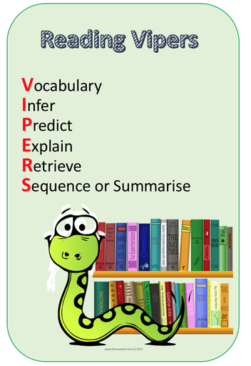
Questions
In school we often use the anacronym VIPERS to prompt effective questioning. This is well regarded in schools across the country. You may already be familiar with this.
By using VIPERS, staff can ensure a range of reading skills are targeted.
Example VIPERS questions you could try are next.

Slide 15
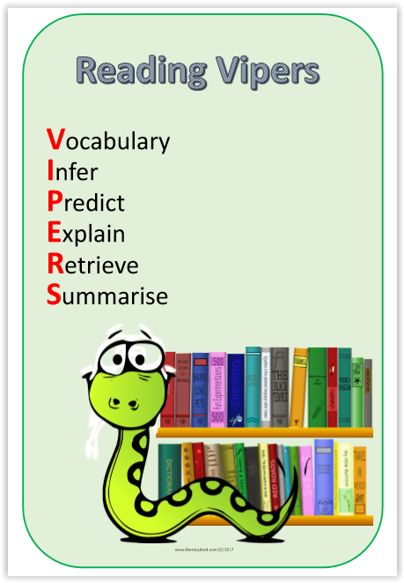
Effective questioning - VIPERS

Slide 16
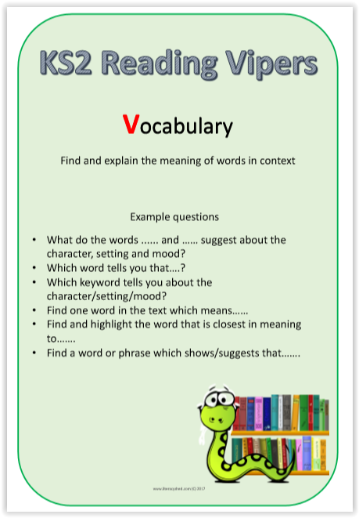

Slide 17
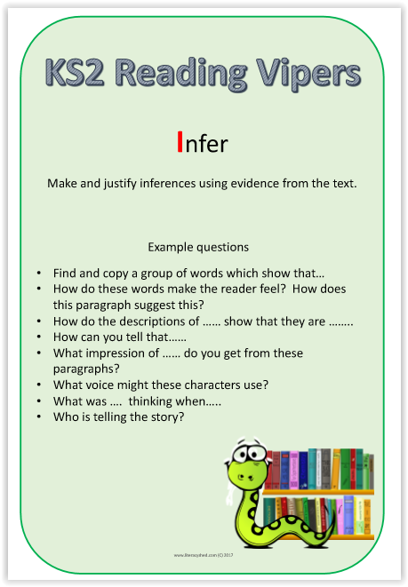

Slide 18
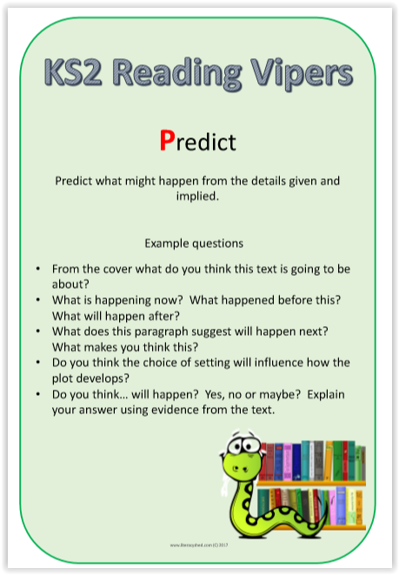

Slide 19
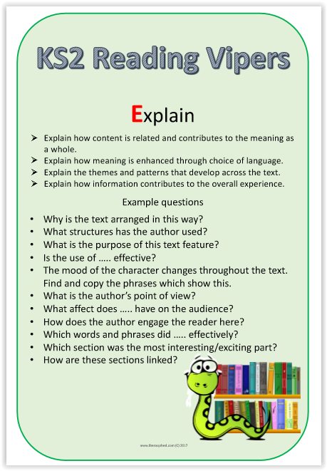

Slide 20
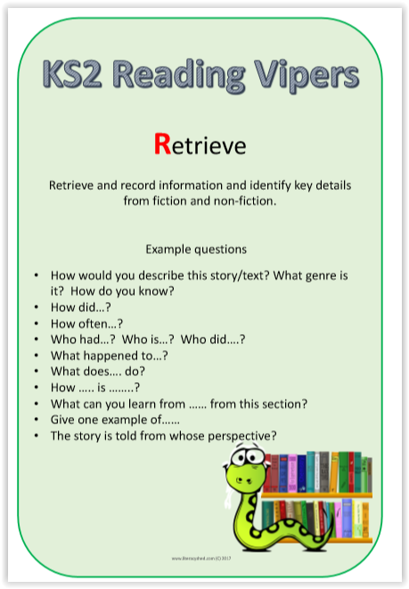

Slide 21
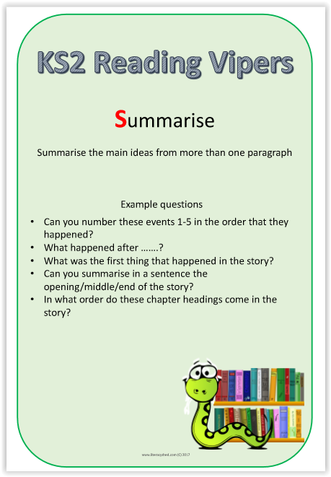

Slide 22
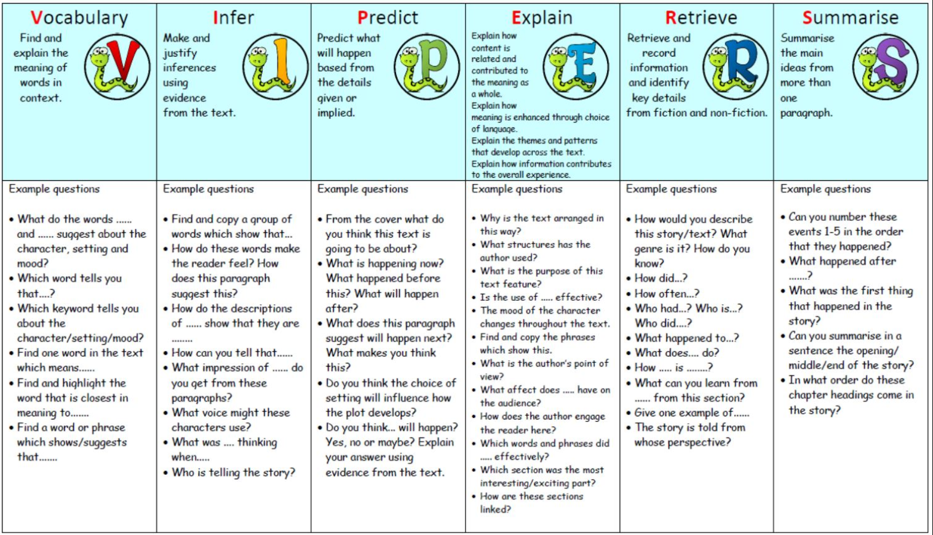

Slide 23
Changing Books
Books are changed regularly in each of the Key Stage Two classes.
Each class has a library day when books can be changed.
Children can also choose to read books from home if they wish to.

Slide 24
Every Opportunity
It is important that children are given every opportunity to read – not just their books from school.
Don’t overlook non-fiction books
Borrow books from the library
Watch a film – discuss what the children have seen. Talk about characters, plot etc. Predict what might happen next and discuss reasons.
Baking - ask your child to read the recipe instructions
On a drive – read the directions/look for signs
Magazines
Newspapers
Be a reading role model. Children will imitate what they see at home, if you can demonstrate an enjoyment of reading, your child is more likely to be enthused to do the same.

Slide 25
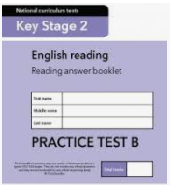
Key Stage 2 SATs
IF you would like to know more about the SATS expectations, the following may be of interest.
Take a look –
Sample and past papers are
available online-
https://www.gov.uk/government/collections/national-curriculum-assessments-practice-materials

Slide 26
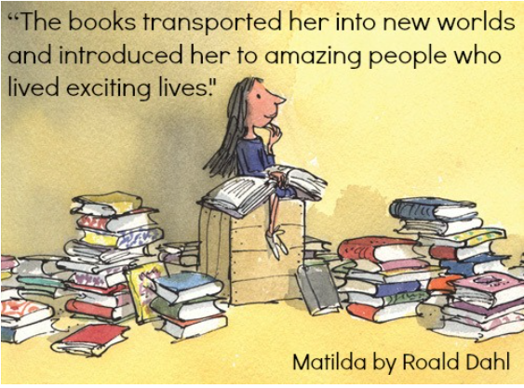
Please remember, learning to read should be a wonderful experience and yes it involves hard work and time but it opens up a magical world for the reader as well as being an important life skill.
Staff are always available if you have any questions, please do get in touch.

